Slide 1





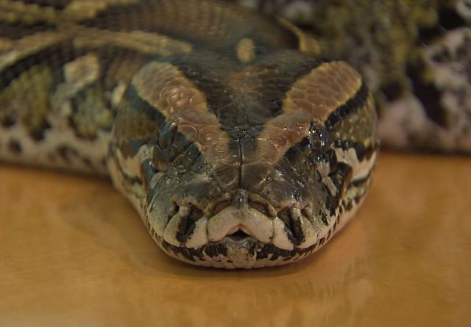


Cyclical Learning Rates for Training Neural Networks With Unbalanced Data Sets
Basel Alyafi, Fakrul Islam Tushar, Zafar Toshpulatov.
Supervisor:
Prof. Francesco Tortorella

Slide 2
Overview
Introduction
Cyclical Learning Rates
Triangular
Triangular 2
Exponential range
Methodology
Experiments
Result and Discussion
Conclusion
CNN Architecture
Cycle Length Estimation
Min and Max LR Boundary Estimation
Case 1, Skewness = 1/17
Case 2, Skewness = 1/36
Metrics
ROC curves
PR curves

Slide 3
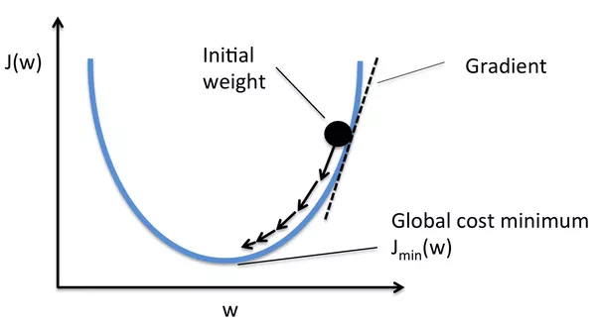
Introduction Learning rate (LR)
LR is one of the most important hyperparameter for fast and optional training of Neural networks.
New weight = Existing weight – Learning rate * gradient
[1]

Slide 4
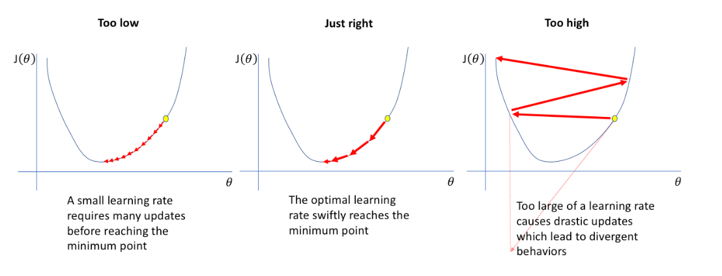
Introduction Learning rate (LR)
[5]

Slide 5
Objective
Use Cyclical Learning rate to train CNN
Use Fixed Learning rate to train CNN
Compare the AUC( Area under curve)
Cyclical Learning Rate
CNN
Training

Slide 6
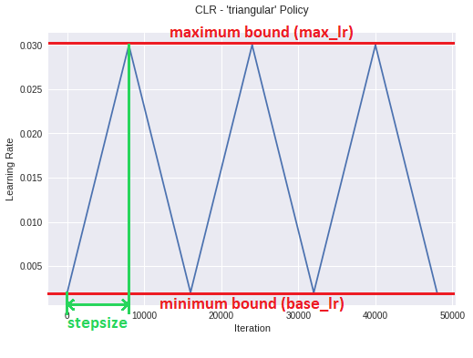

Cyclical Learning Rates (CLR)
cycling using a proper policy
reasonable pre-tuned boundary values
proposed by Leslie Smith
three different policies: triangular, triangular2 and exponential range
Triangular Policy:
$$lr=base_lr+\left(max_lr−base_lr\right)×$$
$$max\left(0, 1−x\right)$$
$$x=abs(\frac{iterations}{2×step_size})$$
$$cycle=floor(1+\frac{iterations}{2×step_size})$$
[2]

Slide 7
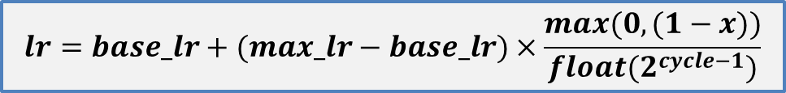
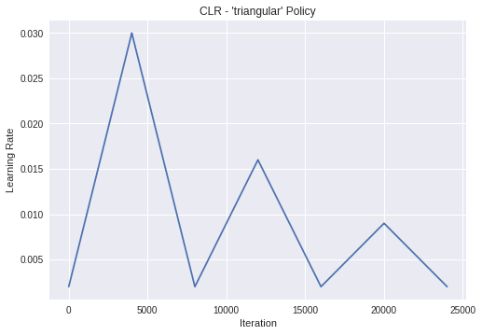
Cyclical Learning Rates Triangular 2 Policy
maximum bound is cut in half at the end of each cycle
[2]

Slide 8
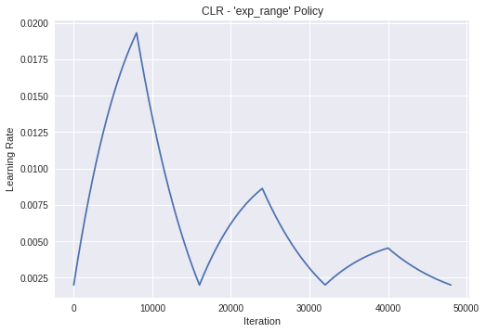
Cyclical Learning Rates Exponential range Policy
scales the cycle amplitude by a factor gamma (iterations)
keeps the base_lr constant
Max decreases by an exponential factor of gamma iteration
[2]

Slide 9
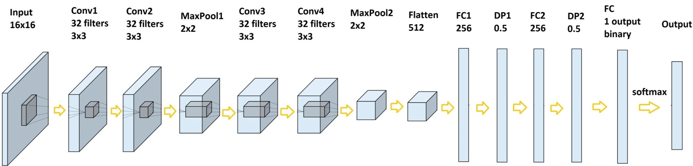
Methodology CNN Architecture
4 convolution layers, 2 max-pooling and dropout.
3 fully connected with a final 2-way softmax activation.
convolution layer has 32 filters.
for faster training, Rectified Linear Unit (ReLu) is used.
pooling layers with filter of size 2 x 2 with a stride 2.

Slide 10
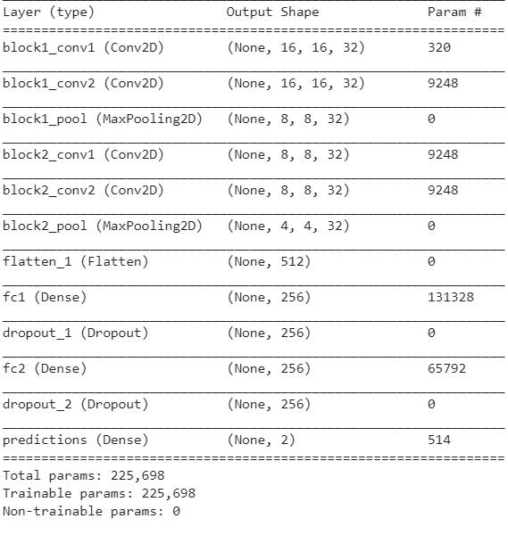
Methodology Model summary

Slide 11
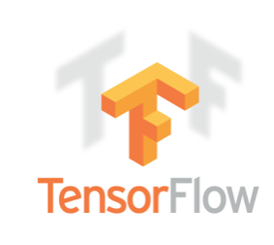

Keras
Environment
Keras is an open source neural network library written in Python
capable of running on top of TensorFlow, Microsoft Cognitive Toolkit, Theano, or MXNet
distributed training of deep learning models
deep models on smartphones (iOS and Android), on the web, or on Java Virtual Machines.
200,000 users as of November 2017

Slide 12


Experiments Environment
All experiments were carried out using GOOGLE COLABORATORY
COLABORATORY is a Google research project
Created to develop deep learning applications using Python
All measurements were made using SKLEARN
ROC and Precision-Recall plots were made using SCIKIT-PLOT
[3]
PROPERTY | VALUE
CPU | Intel Xeon CPU @ 2.20GHz, 1 core
RAM | 12GB
GPU | Nvidia Tesla K80, 24GB

Slide 13
Experiments Environment and hyper-parameters
transferred from tflearn to Keras
training and testing CNN model
experiments were carried out on a data set of 300k breast-micro-calcification gray-scale images (16 X 16 with 16 bit precision).
HYPER-PARAMETER | VALUE
epochs | 12
base_lr | 0.002
max_lr | 0.03
batch size | 32
Train set size | 64k (case 1), 128k( case 2)
epochs per step | 2

Slide 14
Test Data
Environment
Class | Number of sample
Positive Class | 1164
Negative Class | 110k
For testing we used a complete different dataset.

Slide 15
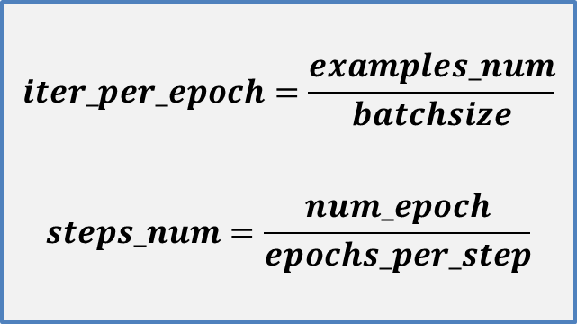
Methodology Cycle Length Estimation
number_of_iterations_per_epoch = number_of_samples / batchsize
step size = 2 - 10 times number of iterations per epoch
12 epochs with step_size = 2 × #iterations_per_epoch

Slide 16
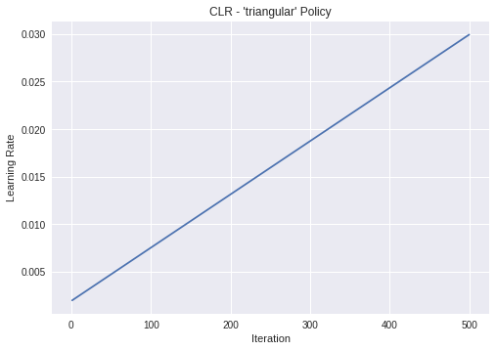
Methodology Minimum and Maximum LR Boundary Estimation
Increase learning rate linearly for a small number of epochs
accuracy (with a balanced under-sampled data set)
The testing was performed setting the base_lr to a small value 0.002, the max_lr to 0.03

Slide 17
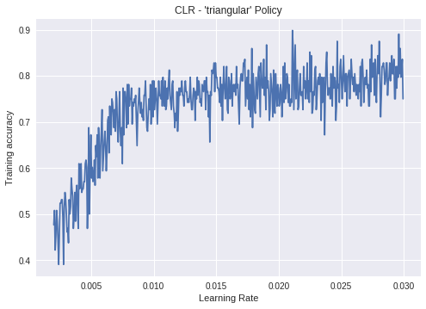
Methodology Minimum and Maximum LR Boundary Estimation
accuracy vs learning rate was plotted
base value is the point where accuracy starts increasing
max value where accuracy starts to slow down, oscillate, or fall

Slide 18

Methodology Minimum and Maximum LR Boundary Estimation
Set step size to total number of iterations in whole experiment (epochs × iterations per epoch)
balanced subset of the entire data set was used consisting 6000 samples 3000 for each class.

Slide 19




Metrics used
ROC curve AUC
Precision-Recall AUC
F1score
Accuracy

Slide 20
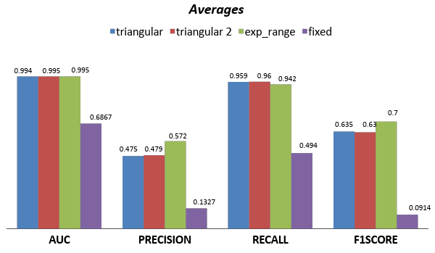
Result and Discussion Skewness = 1/17

Slide 21
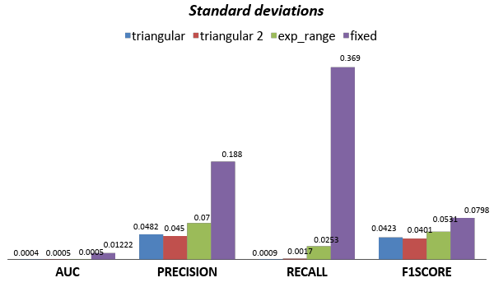
Result and Discussion Skewness = 1/17

Slide 22
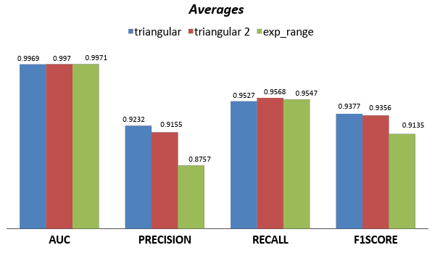
Result and Discussion Skewness = 1/36

Slide 23
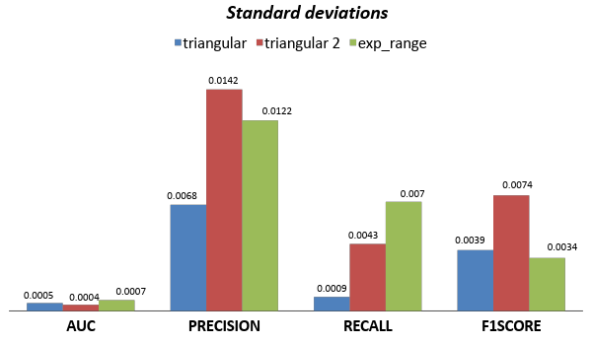
Result and Discussion Skewness = 1/36

Slide 24
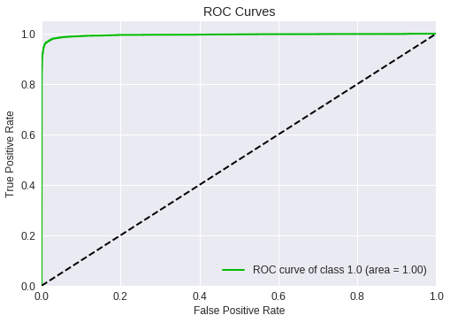

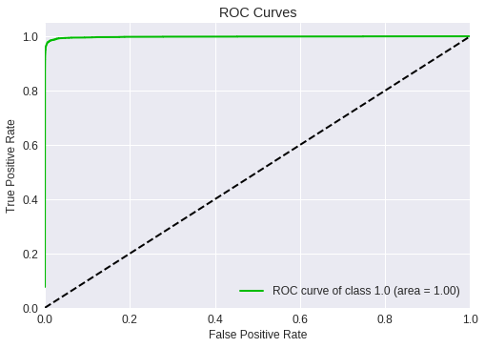
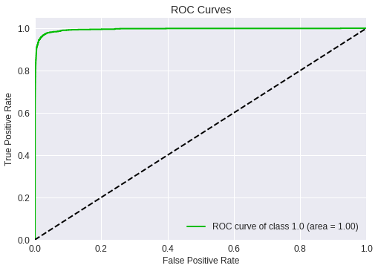
Result and Discussion ROC curve for skew = 1/17
Train
Test
triangular
exp_range

Slide 25

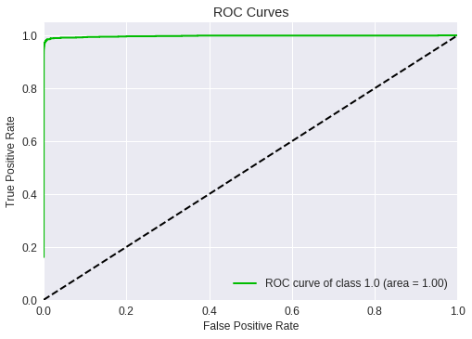


Result and Discussion ROC curve for skew = 1/36
Train
Test
triangular
exp_range

Slide 26
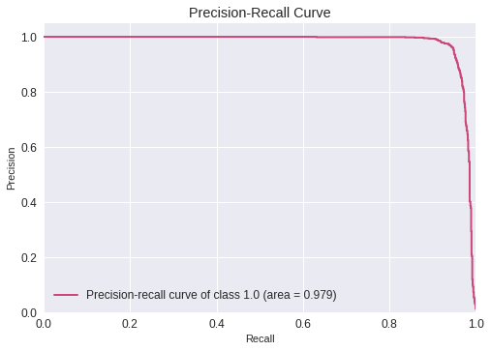
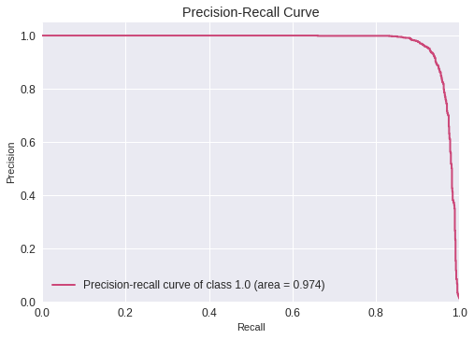
Result and Discussion Test PR curve for skew = 1/36
triangular
exp_range

Slide 27
Conclusion and Future work
CLR can provide optimal classification results with unbalanced data sets.
without a need to tune and often in fewer iterations.
In comparison with fixed rate, all CLR cases provided way better metrics (PR AUC, ROC AUC, F1 score).
In future, CLR could be applied on deeper CNN with different architectures.

Slide 28
References
"Python Machine Learning - Chapter 2 - MLLOG", Mllog.github.io, 2018. [Online]. Available: https://mllog.github.io/2016/11/04/Python-ML-Chapter-2/. [Accessed: 24- Jun- 2018].
Leslie N. Smith. Cyclical Learning Rates for Training Neural Networks. CoRR, U.S. Naval Research Laboratory, http://arxiv.org/abs/1506.01186, Apr. 2017.
Google Colabotary Logo. https://colab.research.google.com/
"Keras Documentation", Keras.io, 2018. [Online]. Available: https://keras.io/. [Accessed: 24- Jun- 2018].
"Setting the learning rate of your neural network.", Jeremy Jordan, 2018. [Online]. Available: https://www.jeremyjordan.me/nn-learning-rate/. [Accessed: 24- Jun- 2018].

Slide 29

PLEASE

